Slide 1
THIS WAY FORWARD
B Corp How-To, Networking & Mentoring Event

Slide 2
Agenda
16:00 Arrivals
16:10 An Introduction to ISN
16:15 What is a B Corp Kelly Harding (Mr Organic)
16:25 Why B Corp? Mel Gooding (Workspace Group)
16:35 Embedding Change Chloe Ibrahim (The Jamie Oliver Group)
16:45 Reporting Progress Ben Hopkins (Bennetts Associates)
16:55 Next Steps, Q&A and Networking
17:30 End

Slide 3
An Introduction to ISN
We collaborate with the private, public and third sectors in Islington to promote best environmental practice, increase social value and support the transition to a Net Zero Carbon Islington.

Slide 4
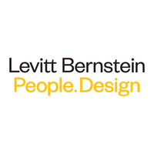
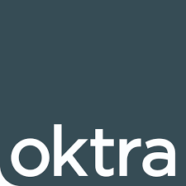
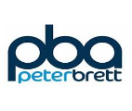
Our Membership
We collaborate with the private, public and third sectors in Islington to promote best environmental practice, increase social value and support the transition to a Zero Carbon
Over 120 members from across Islington varying in size and organisation type

Slide 5
Agenda
16:00 Arrivals
16:10 An Introduction to ISN
16:15 What is a B Corp Kelly Harding (Mr Organic)
16:25 Why B Corp? Mel Gooding (Workspace Group)
16:35 Embedding Change Chloe Ibrahim (The Jamie Oliver Group)
16:45 Reporting Progress Ben Hopkins (Bennetts Associates)
16:55 Next Steps, Q&A and Networking
17:30 End

Slide 6
What is a B Corp?

Slide 7
What is a B Corp?
Benefit Corporation

Slide 8
The Basics
Your business does good in some way
You operate a Triple Bottom Line
You commit to good practices
You study your own impact
People
Planet
Profit
What is a B Corp?

Slide 9
Requirements
For profit company
Trading for 12 months +
Reach 80 points minimum in BIA
Pay a fee
What is a B Corp?

Slide 10
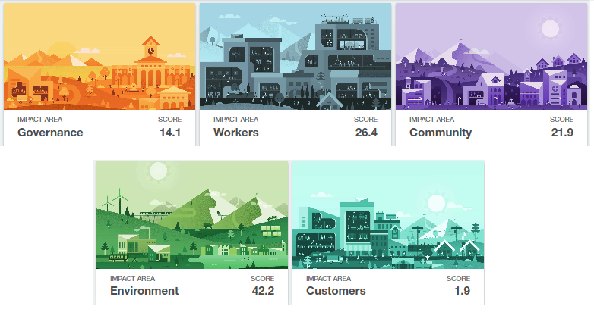
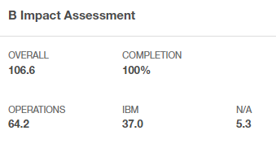
Assessment
IMPACT AREAS
POINTS
OPERATIONS SCORE IBM SCORE
What is a B Corp?

Slide 11
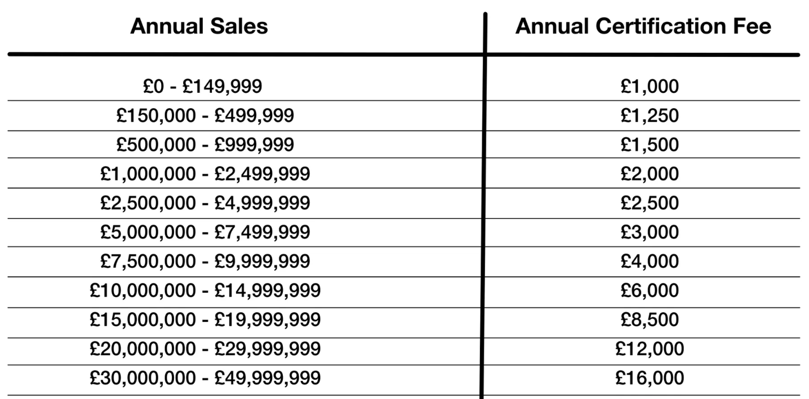
Costs
1-off Submission Fee: £250
Annual Certification Fee: £1000 - £50,000
Bands based on annual sales
Equity Pricing
What is a B Corp?

Slide 12
Why B Corp?

Slide 13
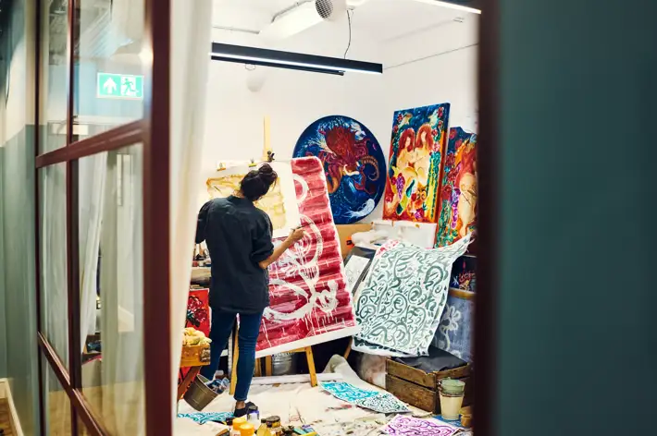
Workspace align to the B Corp Framework
As home to London’s brightest businesses, as custodians of some of the most iconic buildings and as a responsible employer, sustainability is crucial to our long-term success.

Slide 14
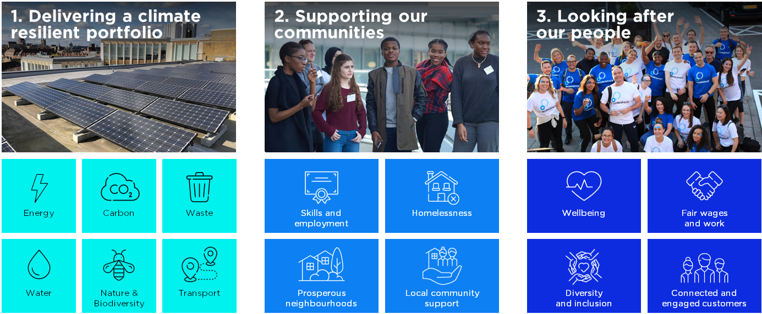
Ensuring a robust sustainability strategy

Slide 15
Ensuring a robust sustainability strategy

Slide 16
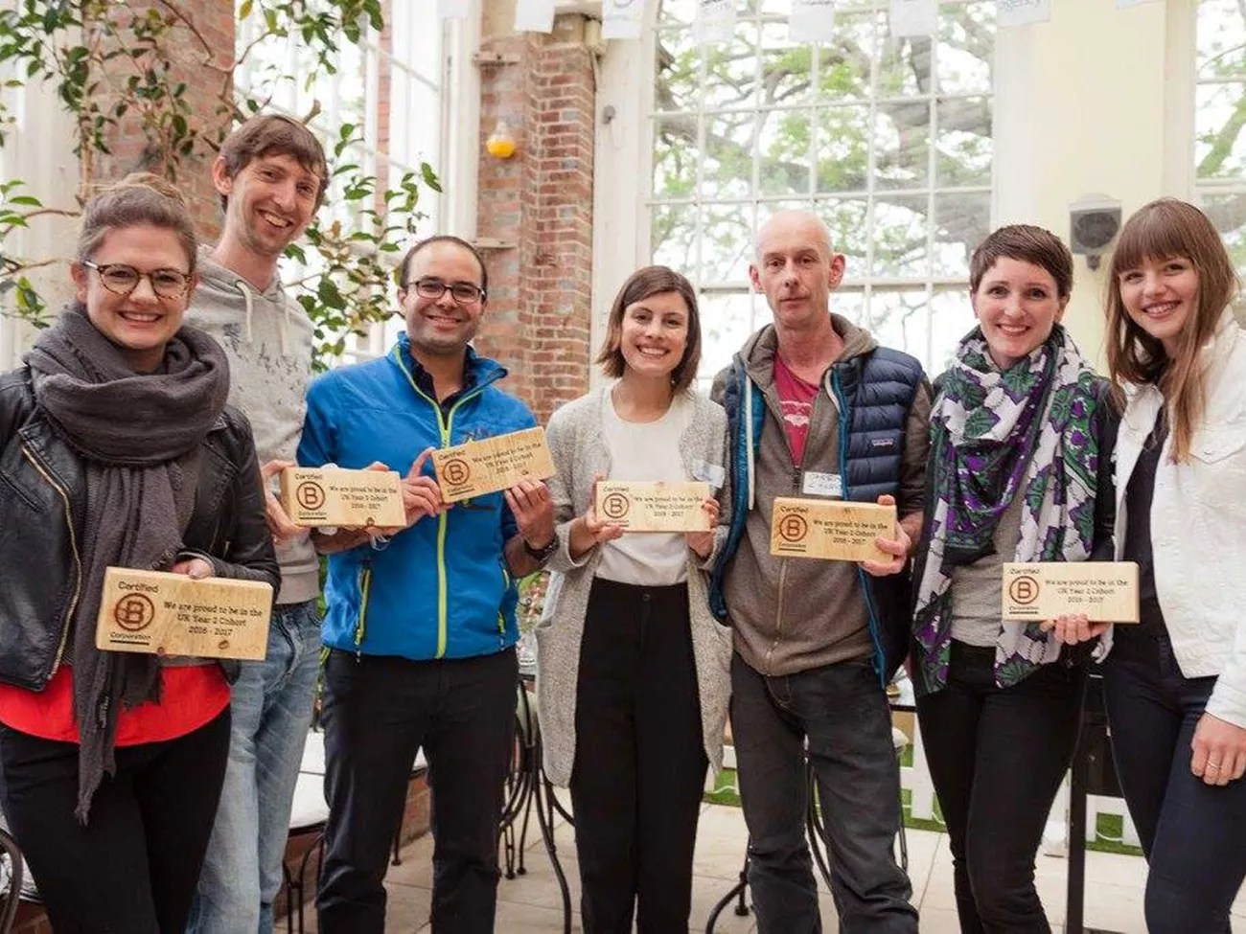
Benefits of B Corp
Businesses that become B Corps have seen great results: committed and motivated employees, increased customer loyalty, higher levels of innovation, and market leadership.
Faster growth in turnover
Growth in employee headcount and higher expectations about future growth
Greater levels of employee retention, engagement and diversity
More robust governance processes
Greater focus on civic and community engagement
Higher levels of innovation
The same likelihood of success at securing external finance -B Lab 2023
Notes:
Download a summary of the research here
Millennials, who will comprise 75 percent of the global workforce by 2025, want to work for organisations that foster innovative thinking, develop their skills, and make a positive contribution to society.
The Deloitte Millennial Survey, 2023

Slide 17
Brand Appeal
The average brand rank across all consumer companies is 5, but 93% of B Corps companies we analysed scored above that average. In fact, 75% of B Corps scored a 9 or 10 on brand rank. (Helios Machine Learning Research, CircleUp)
Notes:
Its becoming more synonymous for good businesses, There are great brands on this slide. One thing common is that all our Bcorp. There is most certainly a brand appeal and association that comes with B corp

Slide 18
B Corp vs Other Certifications
Notes:
Crowded area - lots of certifications for different things - building, product and company wide. B Corp is positioned as a consuming facing certification but is growing interest to shareholders and stakeholders.
BBMG research showed 73& of consumers care about the company and not just the product when making purchasing

Slide 19
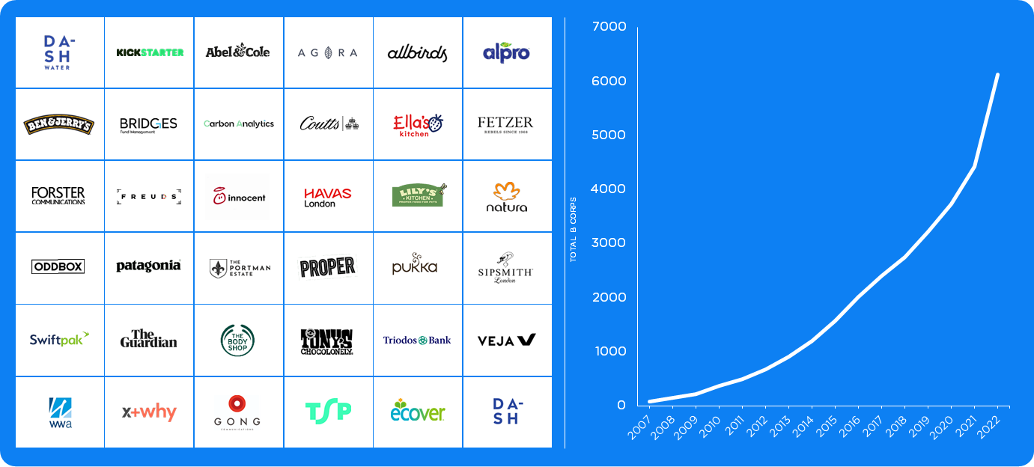
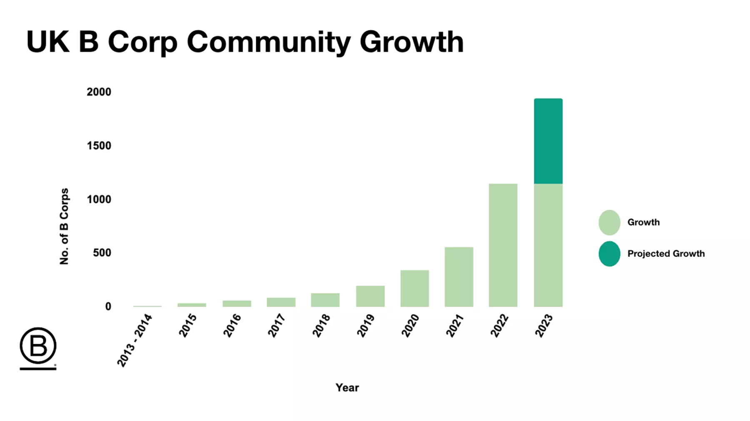
B Corp is a growing movement
Notes:
Demonstration of market leading

Slide 20
Embedding Change
Notes:
Key points:
Certification cycles & the recertification process
Collective responsibility
Keeping up momentum
Evidencing progress
Unlocking Impact Business Models for growth

Slide 21
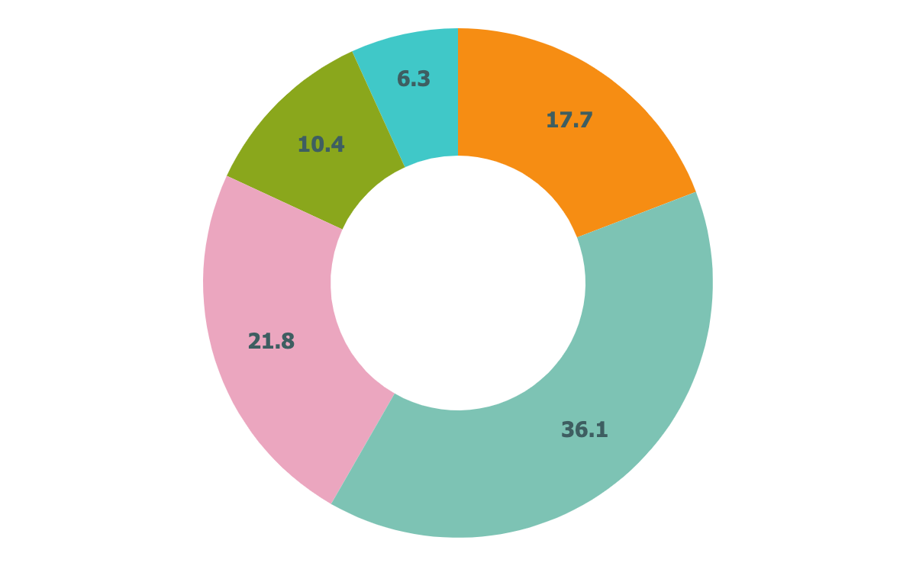
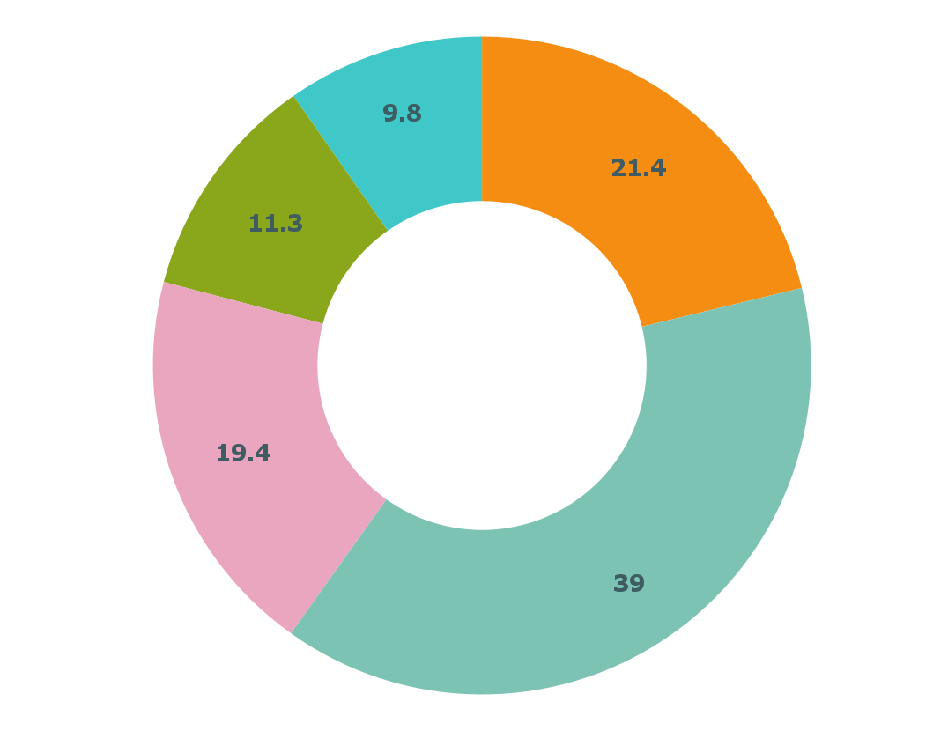
Recertification Cycles
2020:
92.4
POINTS
2021
2022
2023
2024:
101.1
POINTS
Initial certification
Strategy Refresh
Tracking
BIA
Recertification
Jamie Oliver Group first certifies as a B Corp with 92.4 points;
17.7 Governance
36.1 Workerers
21.8 Community
10.4 Environment
6.3 Customers (1 x IBM)
After our first certification we established an internal working group & defined responsibilities, while setting new targets for the next recertification.
After setting our 100 points target for next recertification, we used 2022 to track our progress.
The focus of 2023 was going through the assessment process, closing any gaps & providing all required evidence.
Jamie Oliver Group recertifies with 101.1 points;
21.4 Governance
39 Workerers
19.4 Community
11.3 Environment
9.8 Customers (2 x IBMs)

Slide 22
Collective Responsibility
CEO & Board Level
To commit to B Corp standards & prioritise as part of the bottom line of the business.
Senior Leadership Team
To champion, lead and prioritise the B Corp strategy across their teams.
Structure to drive change both from the top down & the bottom up.
B Corp Lead(s)
Ownership of B Corp to steer the internal working group, act as external B Corp ambassador, track and report improvements, own risk mitigation and project manage recertification.
Internal Working Group(s)
Group of employees across the business, typically those in the detail of the day to day to collaborate on strategy, track progress, discuss issues, problem solve and serve as internal B Corp ambassadors.

Slide 23
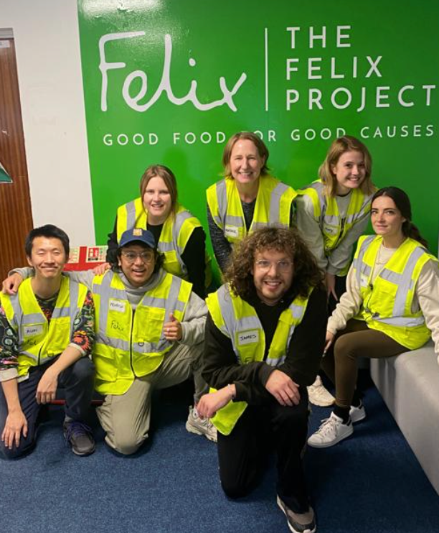
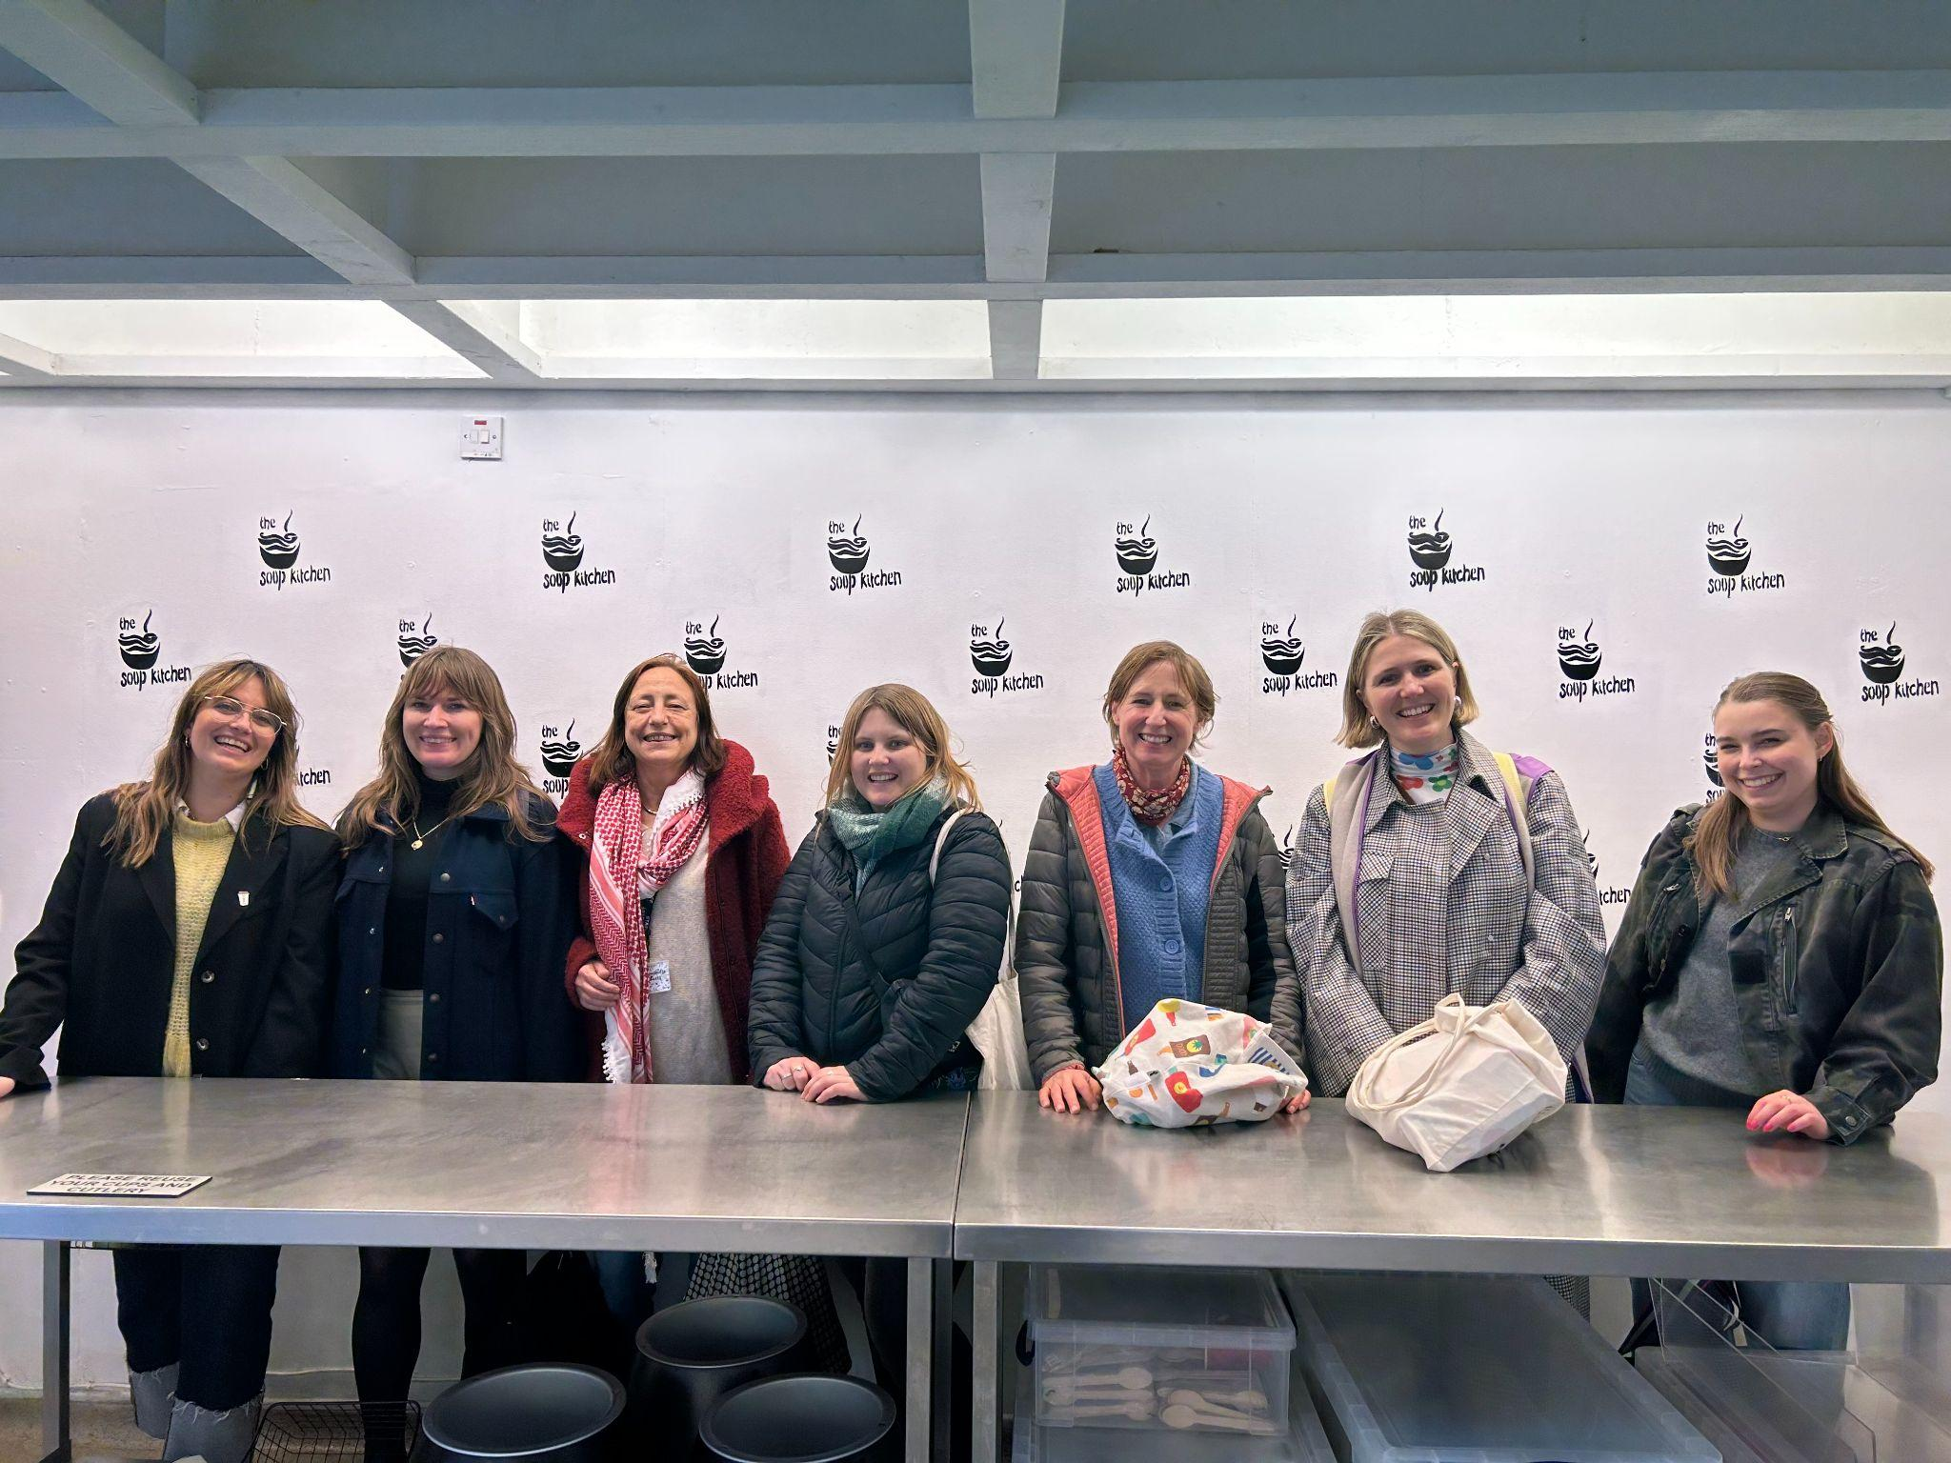
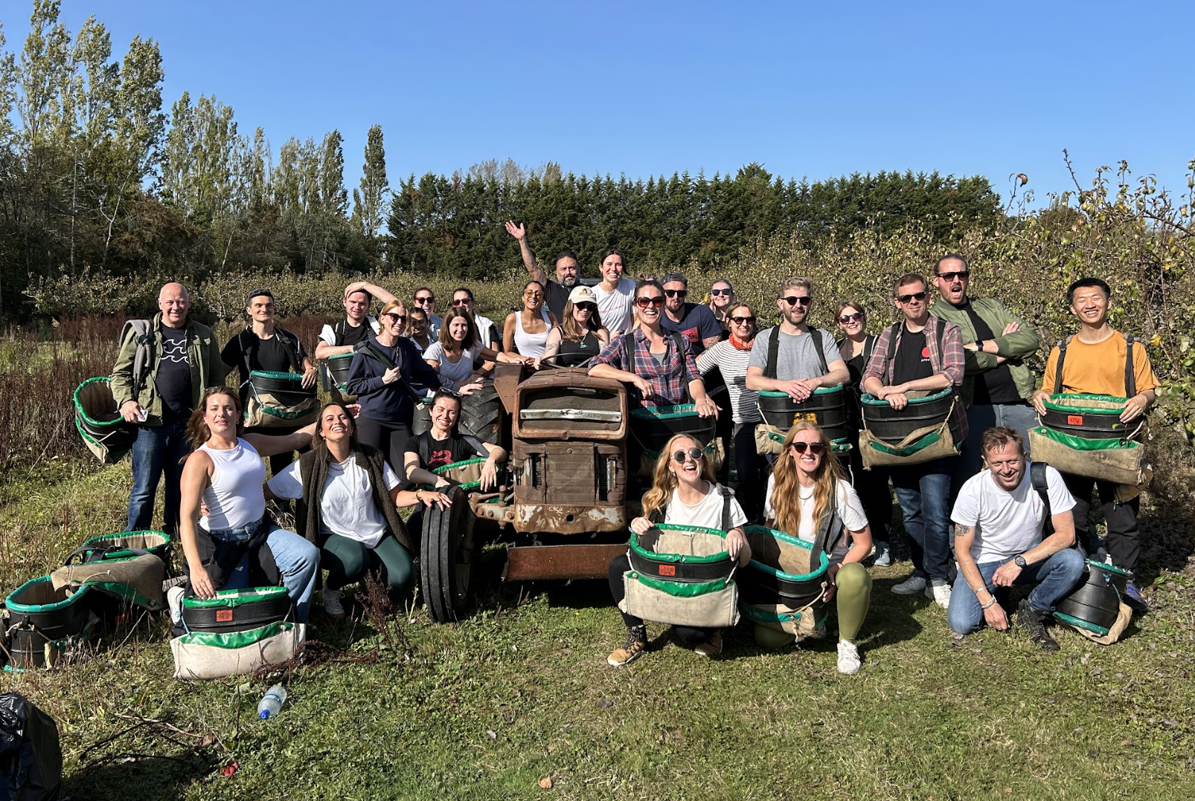
Keeping Up Momentum
Educate & empower the workforce
Conduct regular business updates
Tie B Corp goals into employee goals
Coordinate employee events

Slide 24
Evidencing Progress
Track progress annually
Sync reporting metrics with the BIA
Focus efforts on improvements that are right for your business, and have a significant points increase
Follow B Corp guidelines on evidence

Slide 25
Reporting Impact
When to Report (annually in B Corp Month)
What is included:
Leadership statement
Your journey to date
Review and celebrate progress across all themes and set out what you want to do next
How to report
Blogs,
Poster
KPIs
In Depth Report
Will take content from https://pardot.bcorporation.net/l/39792/2019-11-19/95x7d4/39792/223829/Writing_an_Annual_Impact_Report_by_B_Lab_UK.pdf and https://docs.google.com/presentation/d/1egPO45KBRV8zNtyGvk1HtqzJQpAierVNhAjAeIfrfY8/edit#slide=id.g1367afcf833_0_12

Slide 26
Reporting Impact
“We challenge you to help us move away from the idea (often encouraged by glossy, faultless impact reports) that businesses can be perfect.
We challenge you to become leaders in a new standard of radical transparency, where broader stakeholders are educated about challenges and opportunities for improvement, as well as goals and milestones.”

Slide 27
Reporting Impact
Reports are produced annually for B Corp Month
They are ideally an assessment of your continued improvement (either formally via regular BIA assessments or informally through success stories or lessons learned)
They provide a transparent assessment of your impact across all B Corp Themes
They provide inspiration and help to others

Slide 28
What is Inside?
A Leadership letter summarising the report and signalling buy-in and leadership from the top

Slide 29
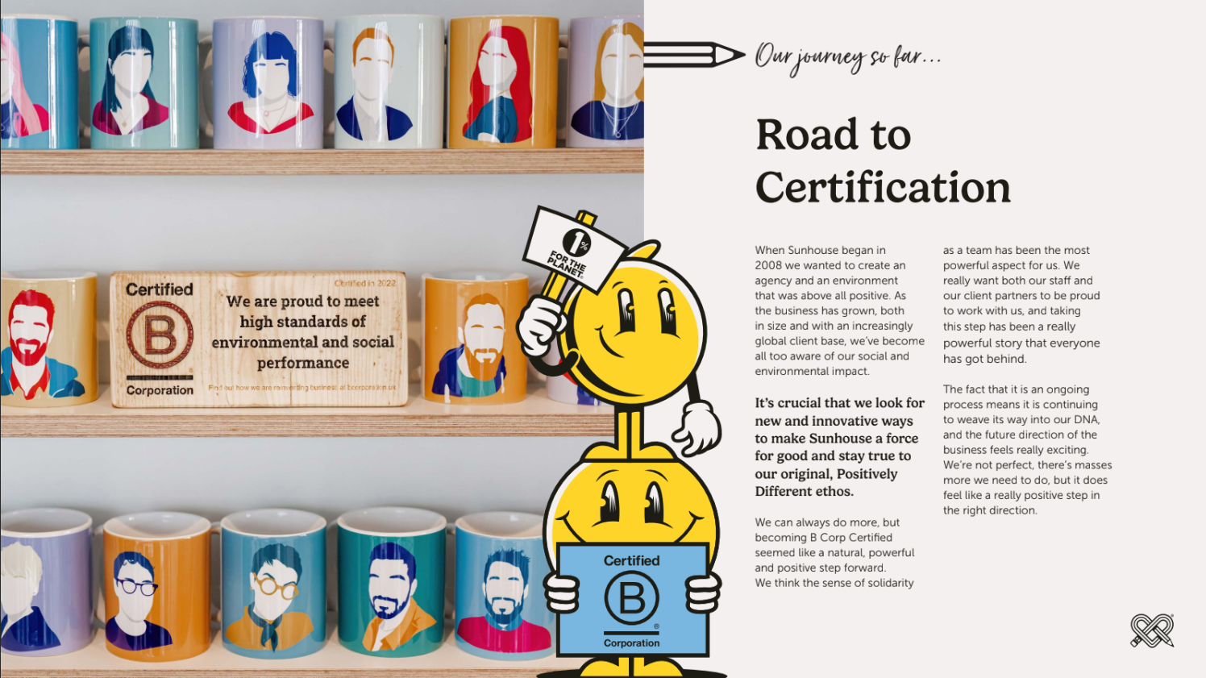
What is Inside?
A Leadership letter summarising the report and signalling buy-in and leadership from the top
An explanation of your journey to become a B Corp

Slide 30
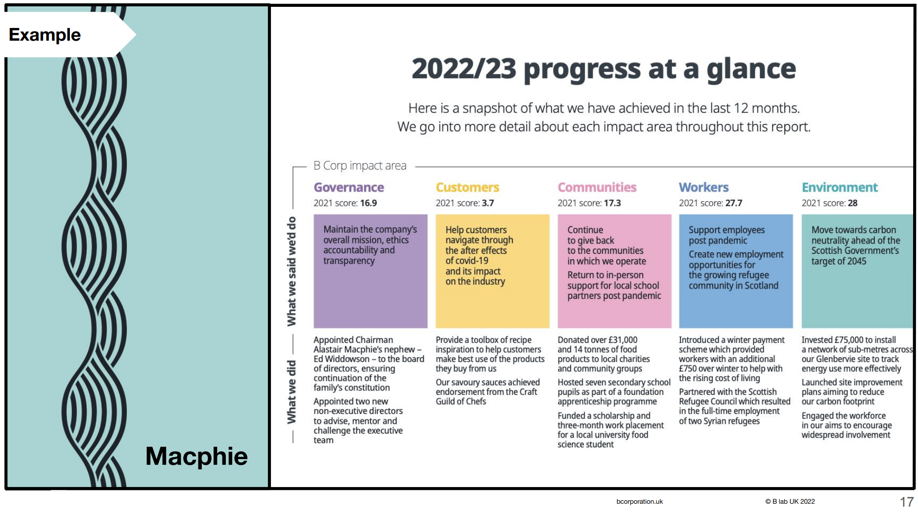
What is Inside?
A Leadership letter summarising the report and signalling buy-in and leadership from the top
An explanation of your journey to become a B Corp
A review of progress in the last year against the 5 pillars and what you said you would do

Slide 31
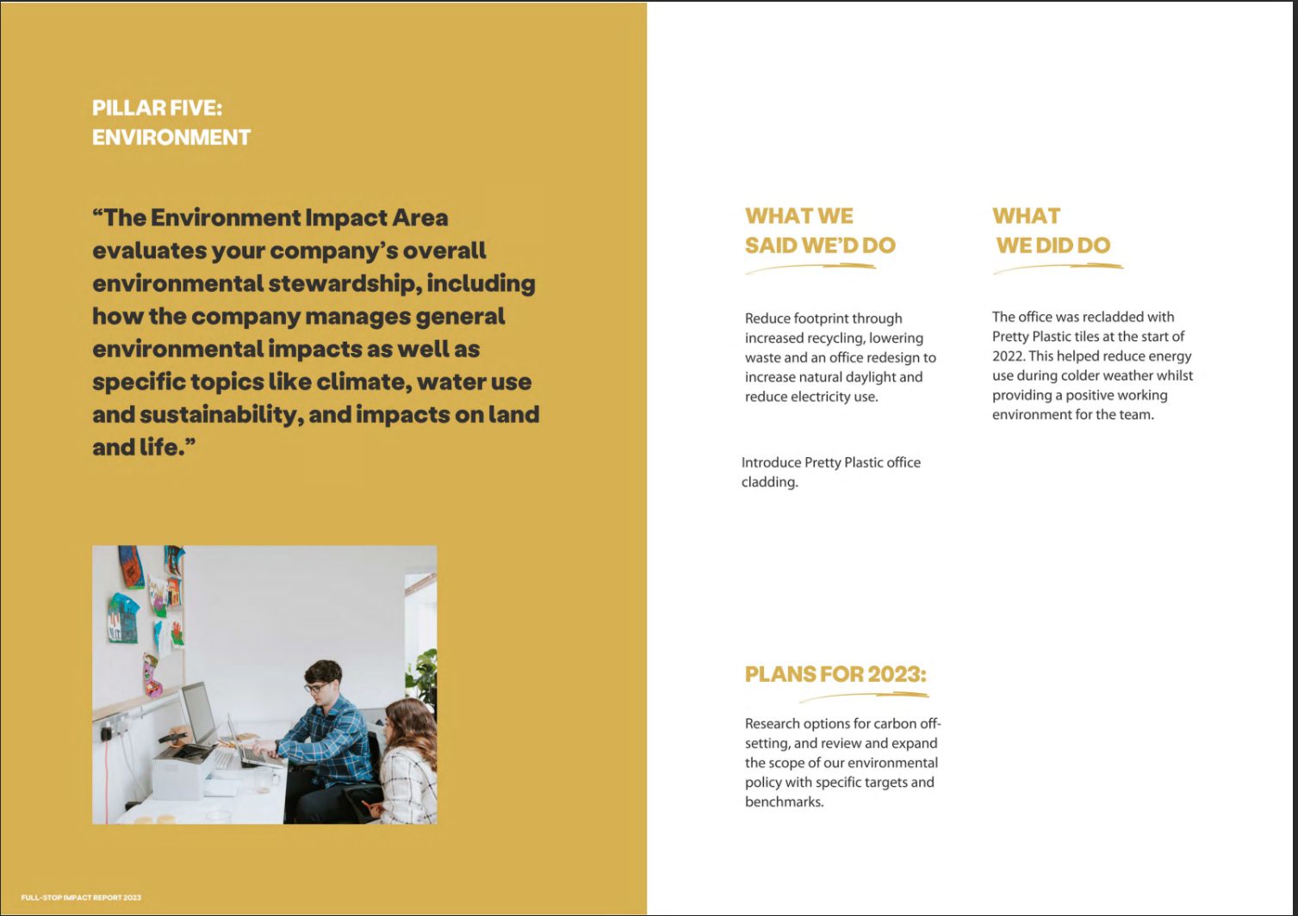
What is Inside?
A Leadership letter summarising the report and signalling buy-in and leadership from the top
An explanation of your journey to become a B Corp
A review of progress in the last year against the 5 pillars and what you said you would do
Goals for the next year

Slide 32
What Does It Look Like?
“Reports” can take lots of formats and follow lots of templates.

Slide 33
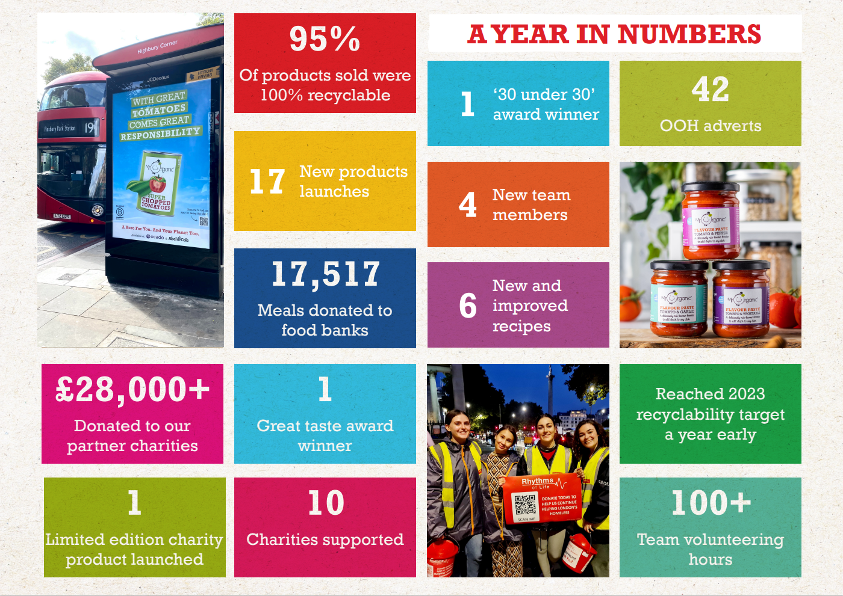
What Does It Look Like?
“Reports” can take lots of formats and follow lots of templates.
From posters and infographics that clearly communicate progress

Slide 34
What Does It Look Like?
“Reports” can take lots of formats and follow lots of templates.
From posters and infographics that clearly communicate progress
To toolkits to help others repeat your success

Slide 35
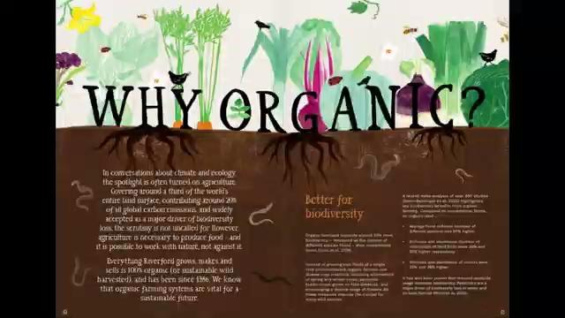
What Does It Look Like?
“Reports” can take lots of formats and follow lots of templates.
From posters and infographics that clearly communicate progress
To toolkits to help others repeat your success
Education pieces

Slide 36
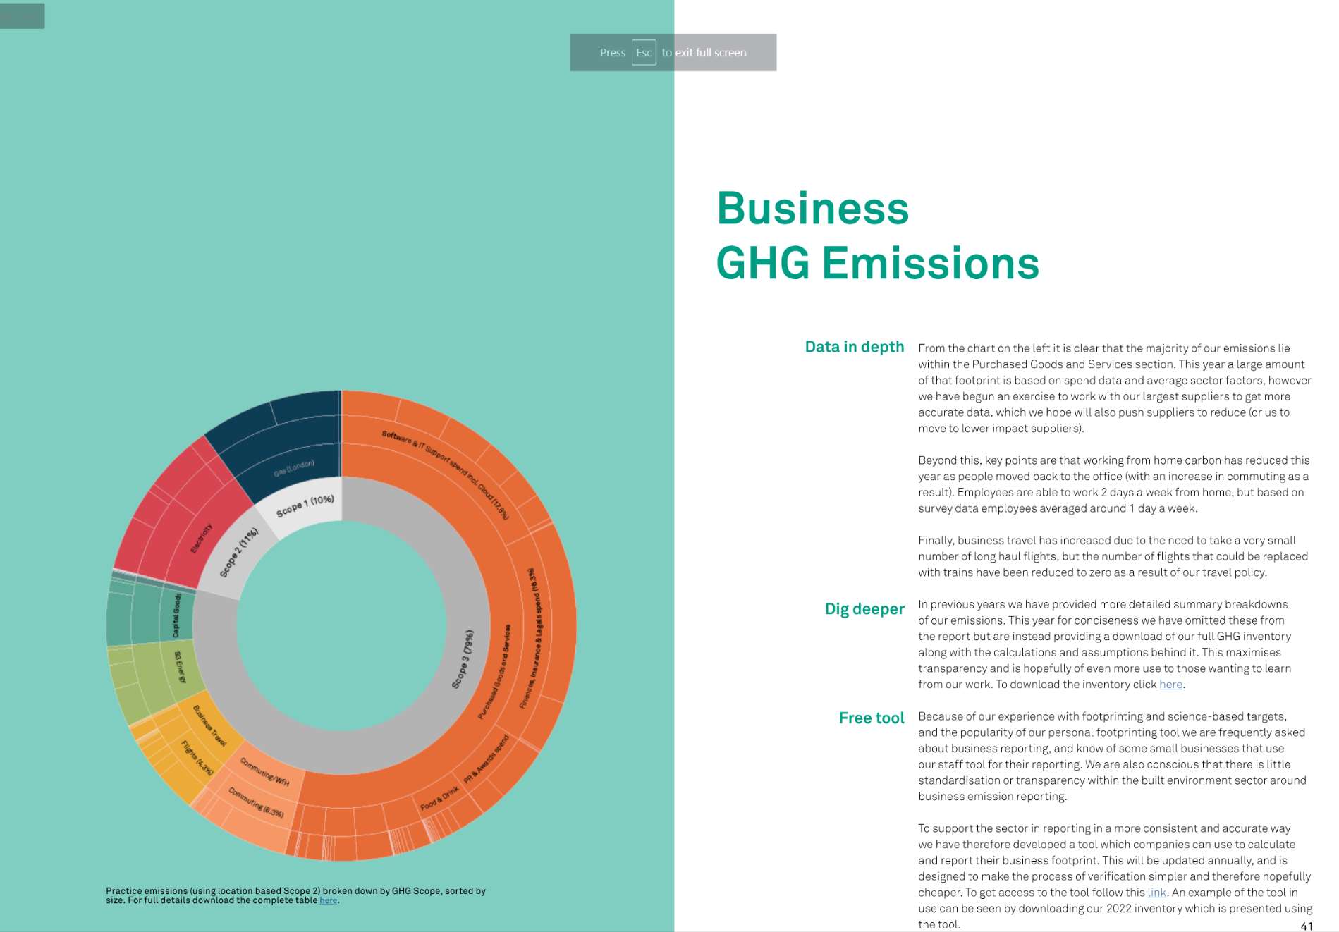
What Does It Look Like?
“Reports” can take lots of formats and follow lots of templates.
From posters and infographics that clearly communicate progress
To toolkits to help others repeat your success
Education pieces
And transparent data releases

Slide 37
Why it Works
It provides a simple framework
It promotes transparency
It gives you an external motivation to keep improving
It makes sure you don’t just concentrate on the one thing you did well on

Slide 38
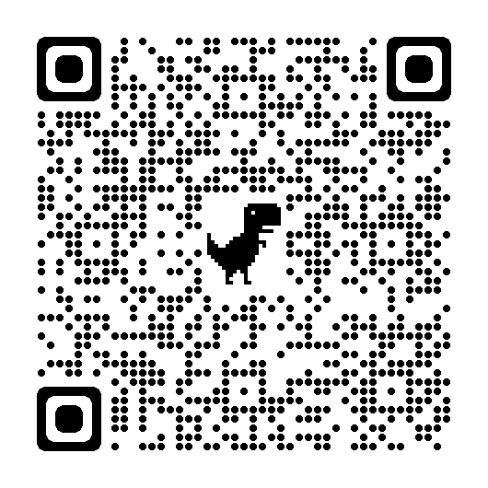
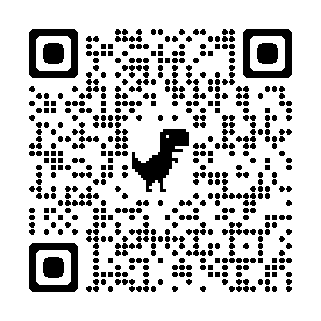
Resources
B Corp Guide with example reports
B Lab Report Word Template

Slide 39
Next Steps

Slide 40
Next Steps and Q&A
Aim to gather a group of interested businesses together who want to start the B Corp Journey
Set up regular mentoring events and a peer learning group
Create a B Local (or informal group) for B Corps in Islington to work together in tandem with ISN
Thanks to Mr Organics and The Roasting Shed for providing refreshments!

Slide 41
Thankyou!
Get in touch at:
hello@islingtonsustainability.network
020 7527 2347
islingtonsustainability.network

