Slide 1
Caxton House Community Centre
Decarbonisation & Energy Saving Advice
Paul Furze, Chief Executive
Sue Collins, Finance and Office Manager
ISN AGM
6 October 2022

Slide 2
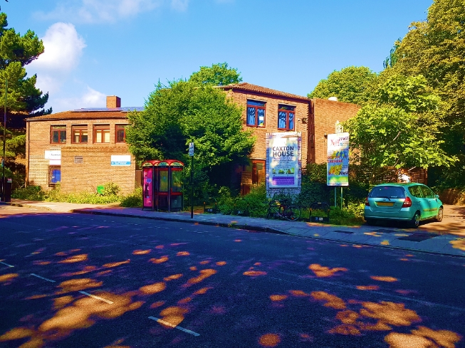
About Caxton House Community Centre
Caxton House is a long-established multi-purpose Community Hub in Islington
We provide a wide range of diverse, highly responsive and community led services and activities to the local neighbourhood
We tackle health inequalities and social isolation, and promote community cohesion
One of our priorities is supporting residents with the cost of living crisis
We are working with Power Up North London on decarbonising our building
2

Slide 3
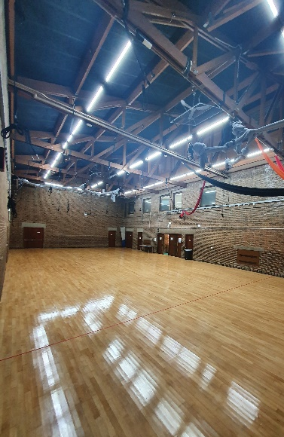
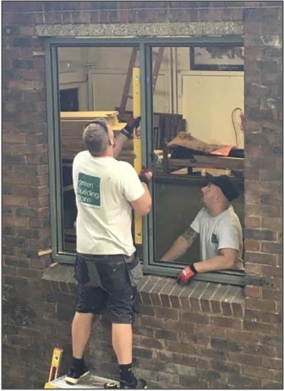
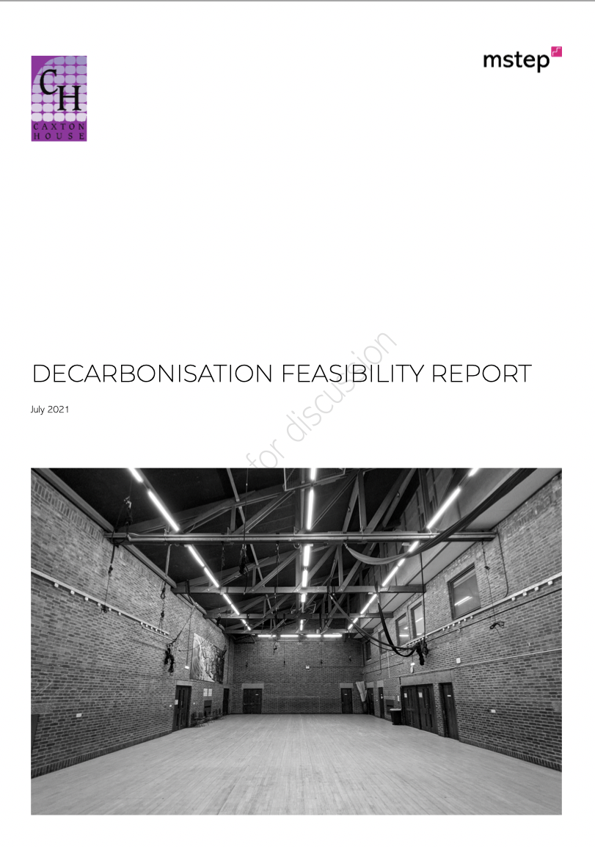
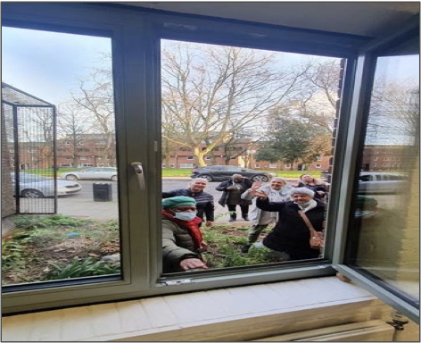
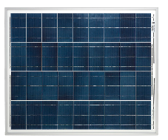
Our path to decarbonisation
2009 Rooftop solar panels
2021 Decarbonisation feasibility report
2022 Triple glazed windows
2017-18 LED lights
52 tonnes of cumulative carbon savings from these actions equivalent to annual emissions from 24 average households – Ofgem stats
3
Notes:
Fabric first..improve energy efficiency of the building fabric before installing a renewable heat solution
Solar PV 2009
LED lights 2017-18
High performance triple glazed windows 2021
Building management system/Mechanical Ventilation 2022
Heat Pump TBD
Grant funding has paid for all measures so far but that model can change if the savings from energy efficiency measures are sufficient to pay for some level of borrowing

Slide 4
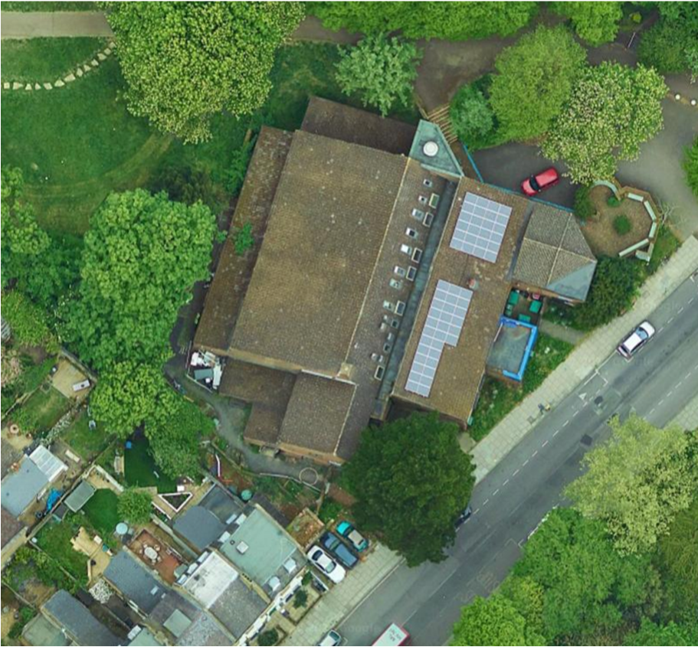
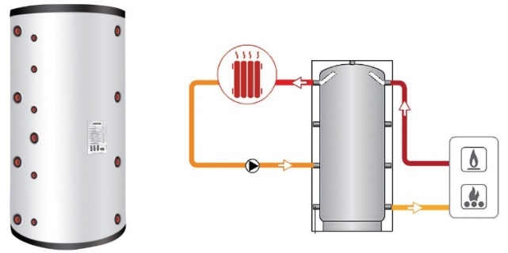
Next step: To reduce carbon emissions by installing a 47kW Air Source Heat Pump (ASHP) by spring 2023
ASHP location
ASHP buffer vessel diagram
4

Slide 5
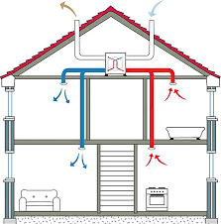
ASHP system install will be coordinated with a Mechanical Ventilation with Heat Recovery (MHVR) system improving energy efficiency and well being
Mechanical ventilation with heat recovery
Building Management System pros/cons being evaluated
14 tonnes of annual carbon savings projected by 2024 equivalent to the emissions by 7 average households each year - Ofgem stats
5
Notes:
Raise match funding for Building Management & MVHR systems
Install both systems
Train staff in use of systems
Raise funding for Air Source Heat Pump
Install ASHP
Monitor and manage c 6-12 months to test performance and make adjustments

Slide 6
The Energy Champions Programme supports individuals and households and will be expanded with further funding
CHCC helps individual households and communities to become ‘energy wise’, reduce energy consumption and save £££s & carbon
Hire experts to run group and individual advice sessions
Raise awareness of discounts and services people are eligible for
Help with switching to cheaper tariffs
Take the time to really listen to people and understand their issues
Refer people to Islington’s SHINE service for follow-ups and home visits
6
Notes:
Champions and community hubs like Caxton House can take longer time with clients, often they need to be listened to as much as get tailored energy advice to be able to get in there and really help on home energy matters, bring different languages and cultural awareness to the table, utilise intelligence already known.

Slide 7
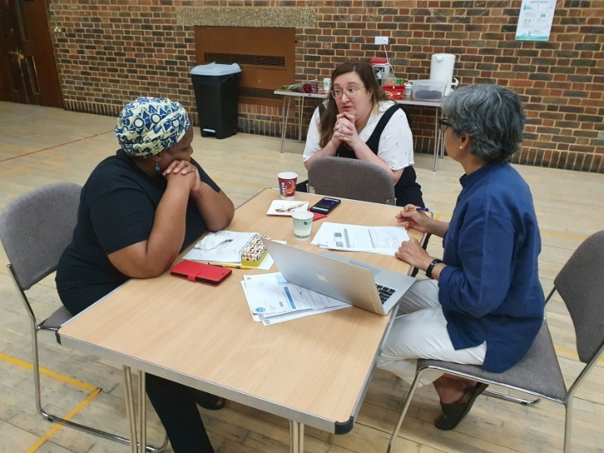
R’s story: 1-1 energy advice is sometimes complex and resource intensive
R is on a low income, lives in social housing, is disabled and on Priority Service Register with her energy supplier
September 2022: R approached CHCC for help dealing with her energy bills and £1,577 of energy bill arrears
CHCC volunteers contacted Shell Energy, Citizens’ Advice and National Debt Helpline to get guidance and provide support
Identified issues with no gas readings since Feb 21 and faulty gas meter
Now following up with a formal complaint and looking to get new meter and significant rebate on backlog billing
Photo of previous energy advice workshops at Caxton House in 2021
7
Notes:
Input from shine - Janet Richards- We have sent a text to say the warm home discount £140 with EDF is open today and to send her account number to apply. Sent out half price water form. Spoken about energy smart meters. Put on priority service register. She is aware of our Energy doctor visits to install small measures to make the home most cost effective and energy efficient. The appointments are re-opening to book late October/early November, she has been made aware of this to call back. We will install measures such as energy saving lightbulbs, reflective panels for radiators etc.. for free. She needs to send more information for a benefit check. She was dealing with a major leak from upstairs when I called and had no credit so I called housing repairs with her to get this sorted. Hope this is also helpful?
Input from Alex: Janet keen to learn more and become an energy champion herself!

Slide 8
Our Funders have made this project possible
8

Slide 9
Contact us
Caxton House Community Centre, 129 St. John’s Way, London N19 3RQ
020 7263 3151 | admin@caxtonhouse.org
www.caxtonhouse.org
Power Up North London info@powerupnorthlondon.org
www.powerupnorthlondon.org
9

