Slide 2
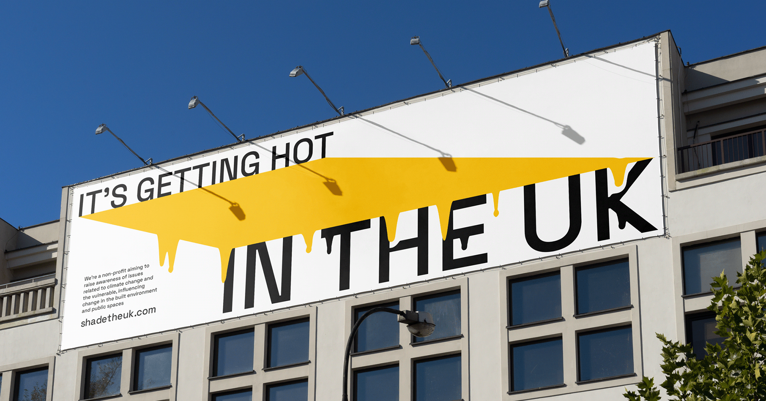

Slide 3
01
WHO WE ARE

Slide 4
We’re a non-profit aiming to
raise awareness of issues related to climate change and the vulnerable, influencing change in the built environment and public spaces.

Slide 5
02
SIGNIFICANCE

Slide 6
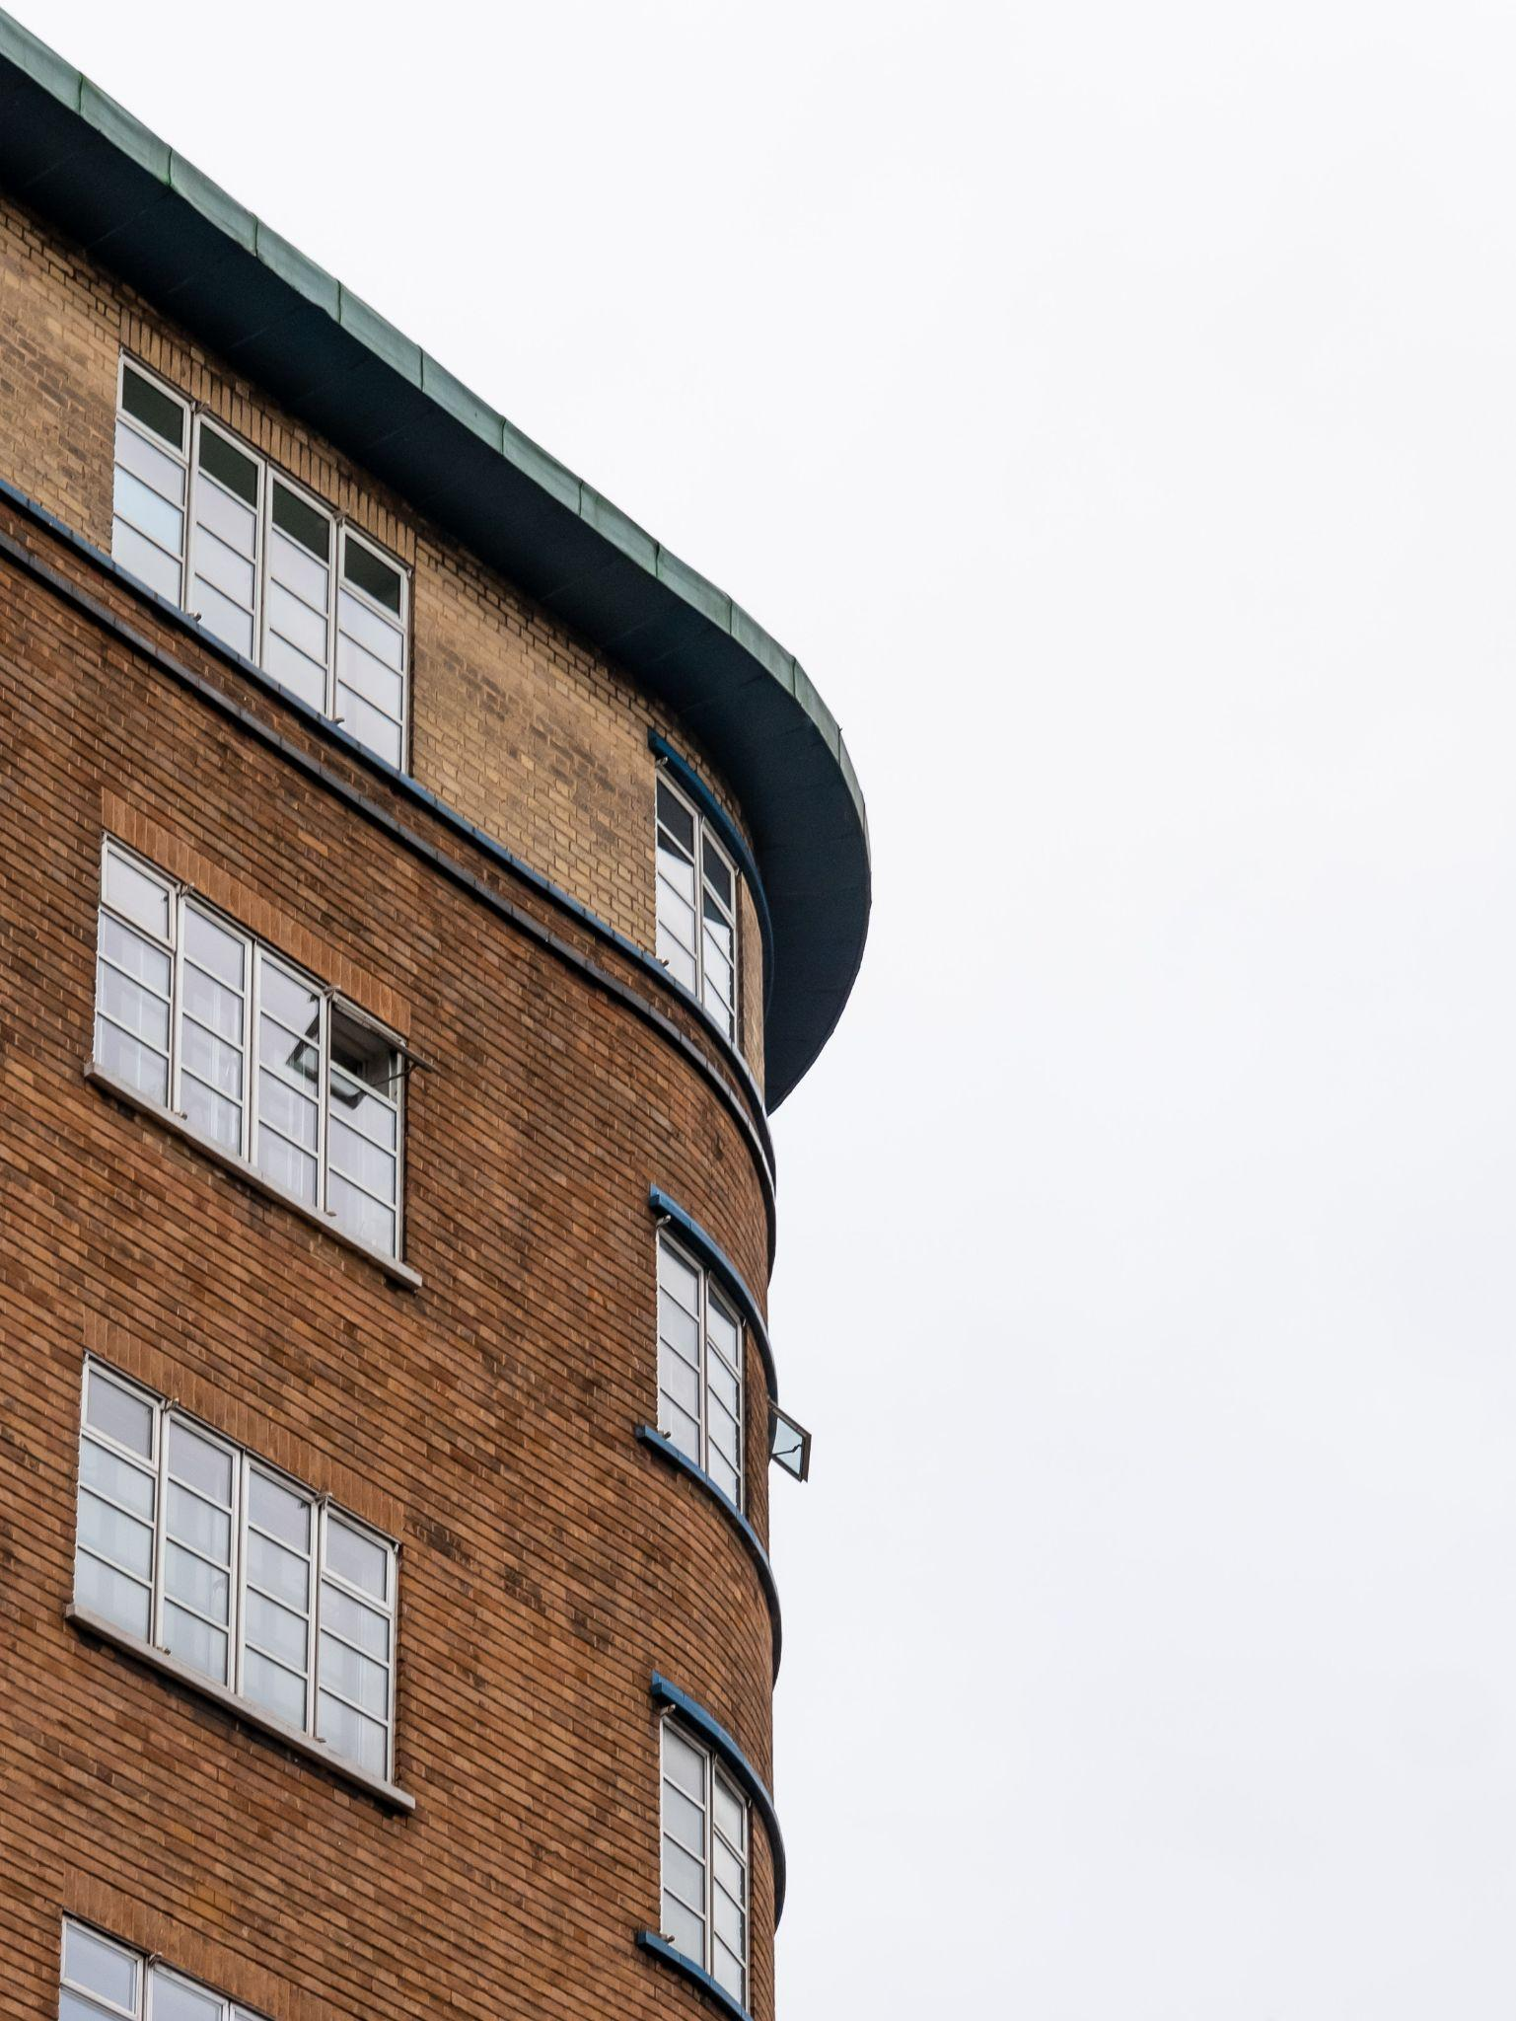
Our current building stock is not equipped for hotter weather.
Densely populated urban areas are already at significant risk of overheating, as are certain other buildings, including houses built in the 60s and 70s.
Notes:
New builds in the UK are doing a decent job in adapting to climate change and preventing overheating, especially through the new Part O building regulations which all new builds must comply with next year.
However, the real problem lies within our current building stock which a large proportion is not equipped for hotter temperatures. The most significantly affected are those in densely populated urban areas. This is especially due to the urban heat island effect which means urban areas retain much more heat than their rural counterparts. And within those urban areas, those built in the 60s and 70s are very prone to overheating.

Slide 7
1 in 5
homes dangerously overheat during heat waves today
2000
caused by heat waves (2021)
excess deaths
Notes:
Even though in the UK all we seem to do is complain about the cold horrible weather, overheating is actually a major issue that not a lot of light has been shed on.
Some scary facts for you, 1 in 5 homes are found to dangerously overheat during heat waves currently. There were also found to be 2000 excess deaths caused by hot weather in the UK in 2021.

Slide 8
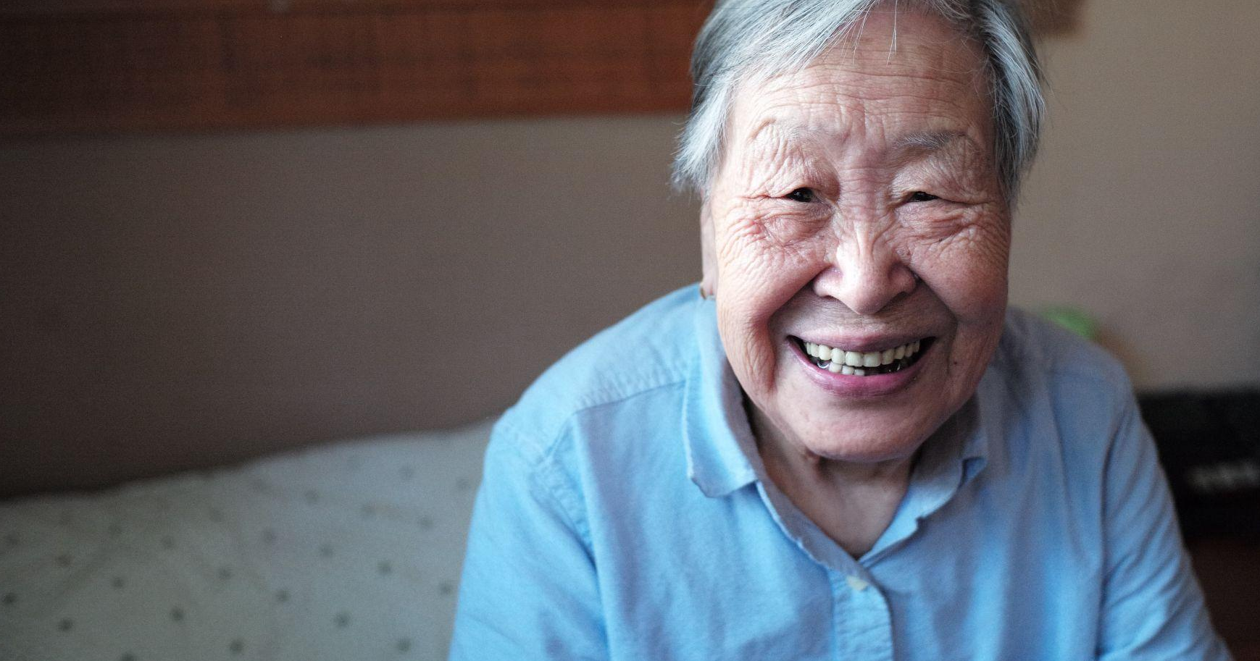
Elderly people, young children and those with long-term health conditions are most vulnerable to the effects of prolonged hot weather.
The main causes of death during a heatwave are respiratory and cardiovascular disease. When air temperatures are high, the body keeps cool through sweating.
This places strain on the heart, which can be fatal for those with underlying heart conditions
Notes:
When we talk about helping the ‘most vulnerable’ to issues relating to climate change and prolonged hot weather, we are mostly referring to
Young children
Elderly
Those with long term health conditions
Especially prominent within the last 2 groups, the main causes of death during hot weather are respiratory and heart diseases. This is because when air temperatures are high, the body keeps cool through sweating. But this places strain on the heart which can be fatal for those with underlying health conditions.
Other notable mentions of vulnerable people that we aim to help are:
Those living in social housing, as a lot are not built to withstand hot weather
Pregnant people
Economically disadvantaged
The homeless
Those with disabilities

Slide 9
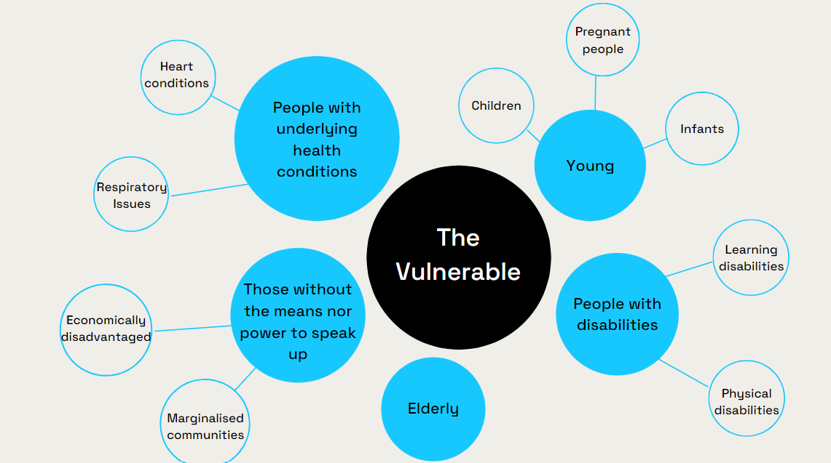

Slide 10
This overheating crisis will only worsen as by 2040 climate change is estimated to triple heat related deaths to
7000
Notes:
As I mentioned early there are currently around 2000 excess deaths per year due to overheating, which sounds scary already, but this is expected to more than triple in numbers by 2040 due to climate change. As this will unfortunately bring increased frequency in extreme weather events, such as storms, extreme precipitation, and most notably heat waves.

Slide 11
03
WHAT WE DO

Slide 12
Raise Awareness
Highlight the effects of climate change on the vulnerable and elderly in the UK to both industry and the general public.
Build a network and alliance between the public and designers to help shape our City to meet the demands of climate change

Slide 13
Raise Awareness
Influence Change
Highlight the effects of climate change on the vulnerable and elderly in the UK to both industry and the general public.
Build a network and alliance between the public and designers to help shape our City to meet the demands of climate change
Encourage the government and industry to invest more into retrofit projects that provide external shade and other passive cooling strategies to existing buildings and public spaces
Provide advice and solutions to vulnerable people who are experiencing overheating issues in their home.
Notes:
Secondly, we want to influence change in the industry and government. As new builds will now adapt to overheating, we want to encourage more retrofit projects that will provide cooling to the existing building stock. A lot of these can be quite simple, passive cooling techniques such as fitting all windows with blinds, and having proper ventilation. We also want to extend this to cooling down public spaces, so creating more green spaces and external shading.

Slide 14
Raise Awareness
Influence Change
Reimagine
Highlight the effects of climate change on the vulnerable and elderly in the UK to both industry and the general public.
Build a network and alliance between the public and designers to help shape our City to meet the demands of climate change
Encourage the government and industry to invest more into retrofit projects that provide external shade and other passive cooling strategies to existing buildings and public spaces
Provide advice and solutions to vulnerable people who are experiencing overheating issues in their home.
Envision a new future for London that is fully adapted to a warmer climate.
Facilitate design ideas across London to improve the existing building stock and public spaces through shading and urban greening.
FUND PROJECTS
Notes:
Lastly, in the future we aim use our expertise in the built environment oto spark innovation and facilitate design ideas to better prevent the impacts of overheating.

Slide 15
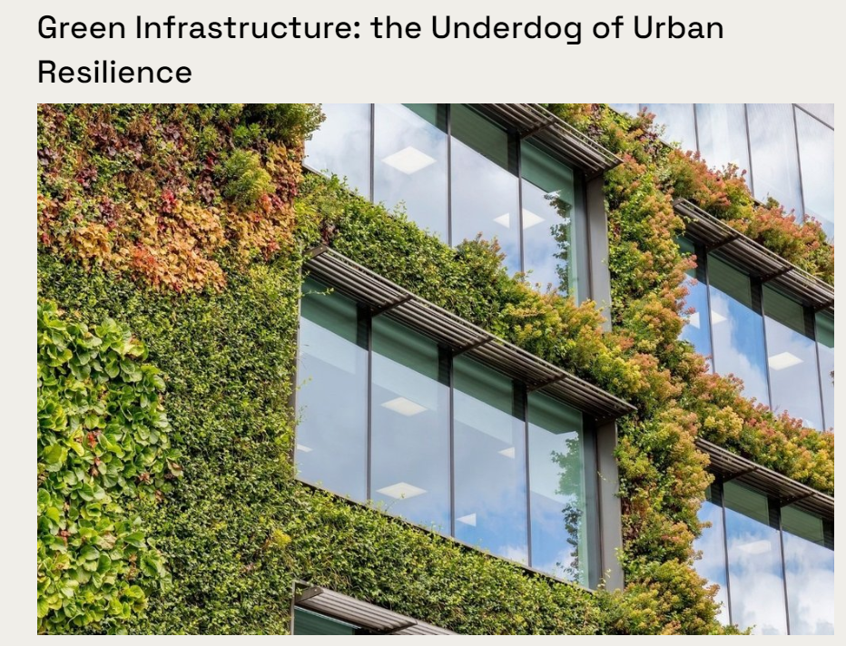
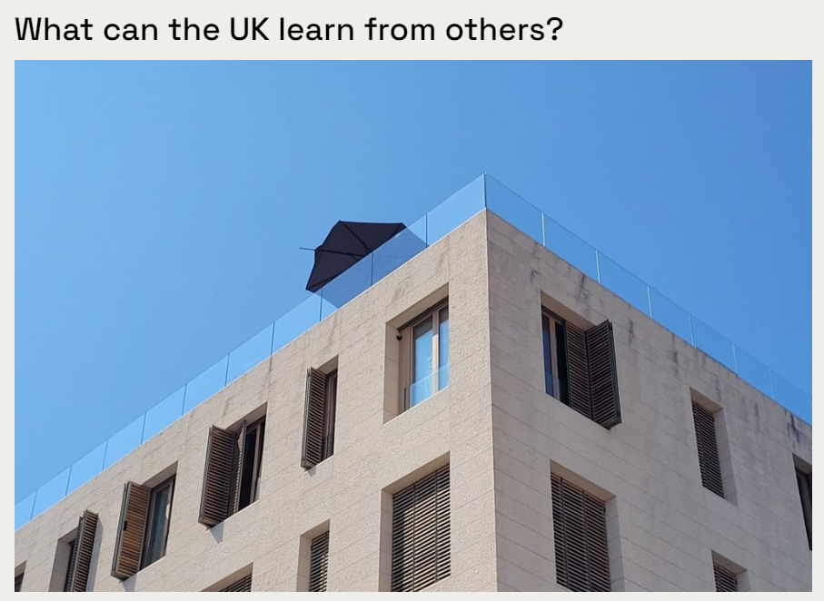
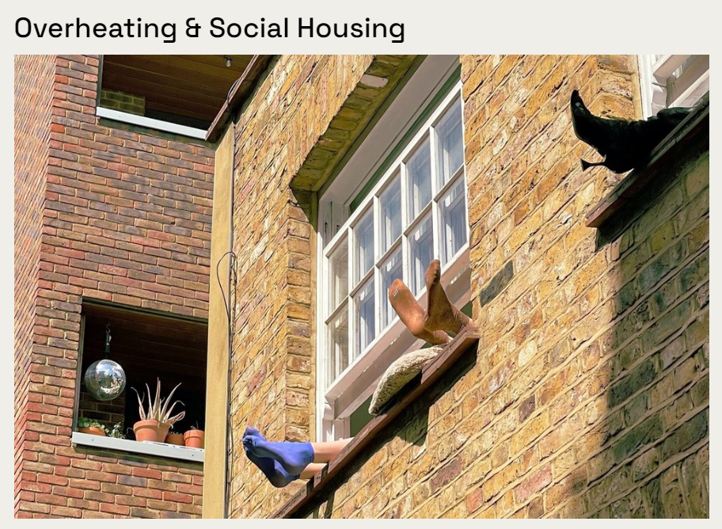
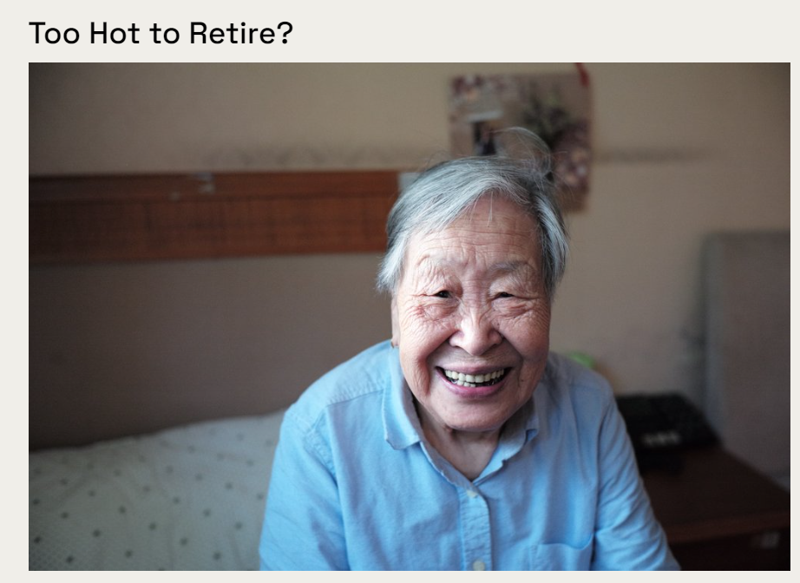
Info Hub
Notes:
Finally, we want to be a platform for those who are passionate about climate change and related issues. On our website we have an info hub, which is where we are writing and posting articles. For examples, some of the ones we have posted so far are on green infrastructure and how it is vital for urban resilience, one on how the UK can adapt to climate change using methods from countries who have always existed with warmer temperatures. Then there are others on overheating issues regarding social housing and another with the elderly.

Slide 16
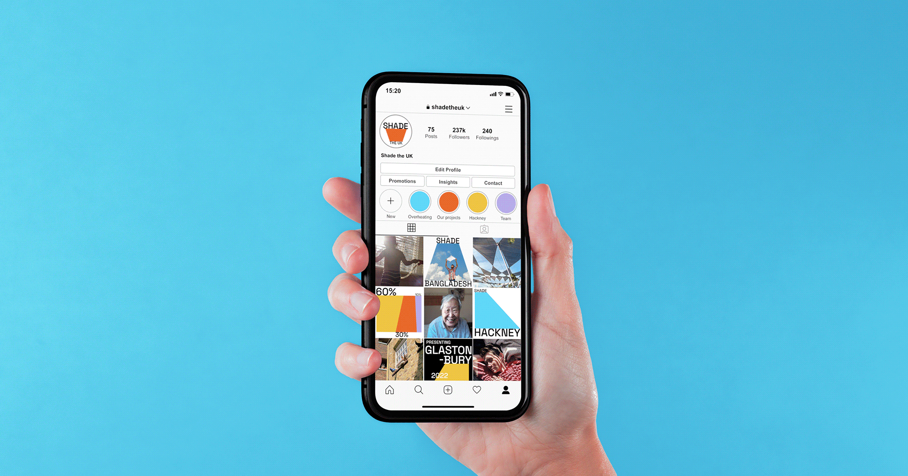
@shade.the.uk

Slide 17
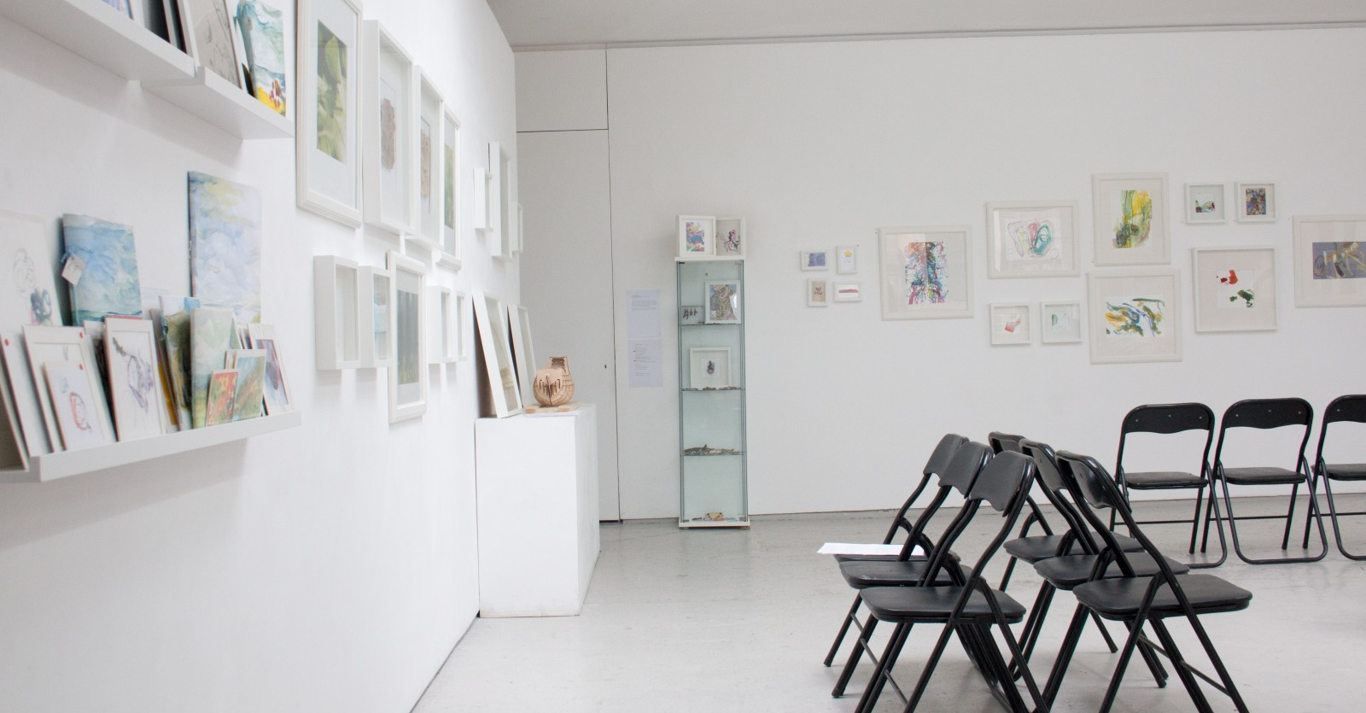
Design Competition

Slide 18
Spreading the Word

Slide 19
Spreading the Word

Slide 20
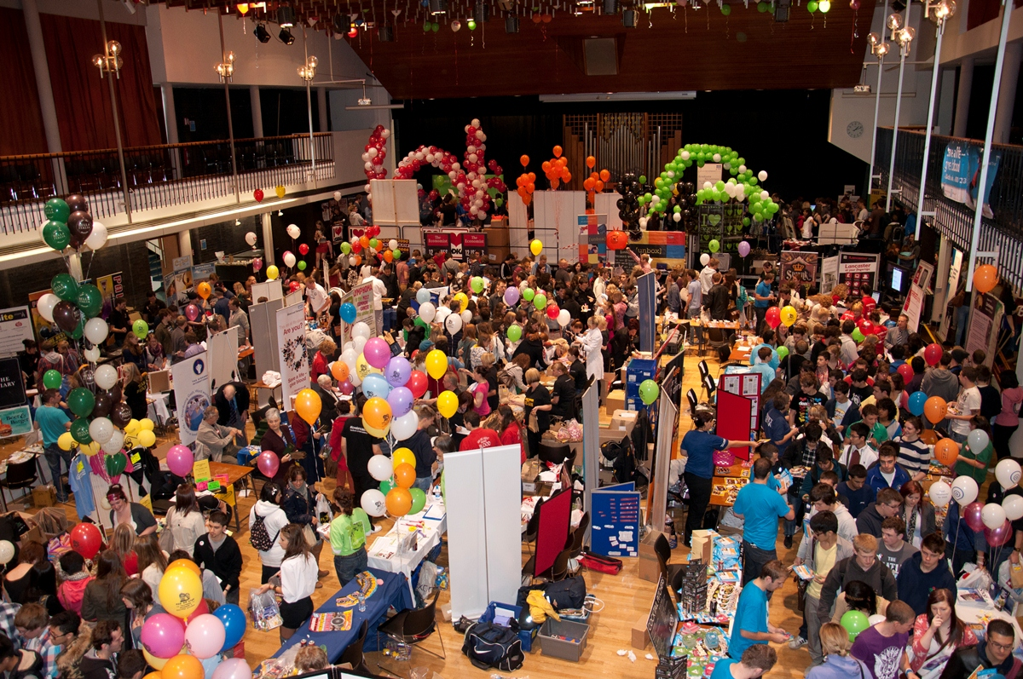
Universities

Slide 21
Where are the issues?

Slide 22
Thank you!
@shade.the.uk
Shade the UK
(+44) (0) 20 7846 0261
info@shadetheuk.co.uk
Notes:
That is it for today, thank you all so much for listening.
I would be extremely grateful if you could give us a follow on instagram and connect with us on linkedin.
Thank you! Enjoy the food!

